Slide 1
Splay Tree Data structure

Slide 2
Definition
Splay tree is another variant of a binary search tree. In a splay tree, recently accessed element is placed at the root of the tree. A splay tree is defined as follows…
Splay Tree is a self - adjusted Binary Search Tree in which every operation on element rearranges the tree so that the element is placed at the root position of the tree.

Slide 3
Splaying
In a splay tree, every operation is performed at the root of the tree. All the operations in splay tree are involved with a common operation called "Splaying".
Splaying an element, is the process of bringing it to the root position by performing suitable rotation operations.
In a splay tree, splaying an element rearranges all the elements in the tree so that splayed element is placed at the root of the tree.

Slide 4
Rotations in Splay Tree
In splay tree, to splay any element we use the following rotation operations...
1. Zig Rotation
2. Zag Rotation
3. Zig - Zig Rotation
4. Zag - Zag Rotation
5. Zig - Zag Rotation
6. Zag - Zig Rotation

Slide 5
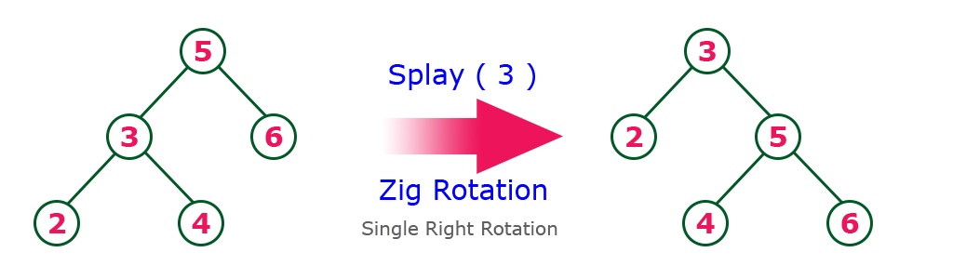
Example
The Zig Rotation in splay tree is like the single right rotation in AVL Tree rotations. In zig rotation, every node moves one position to the right from its current position. Consider the following example...

Slide 6
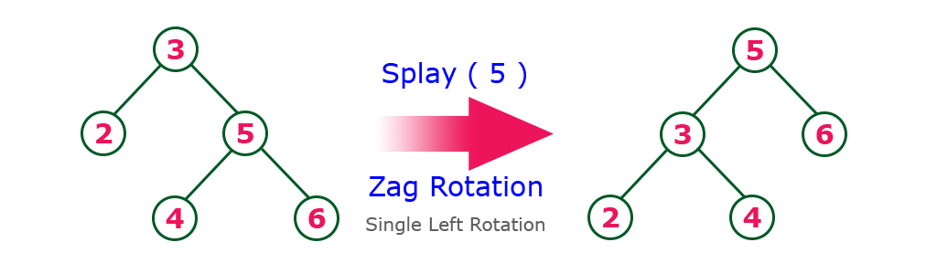
Zag Rotation
The Zag Rotation in splay tree is like the single left rotation in AVL Tree rotations. In zag rotation, every node moves one position to the left from its current position. Consider the following example...

Slide 7
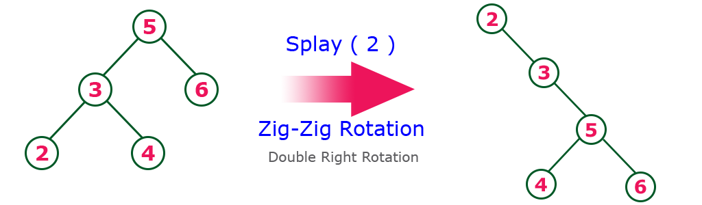
Zig-Zig Rotation
The Zig-Zig Rotation in splay tree is a double zig rotation. In zig-zig rotation, every node moves two positions to the right from its current position. Consider the following example...

Slide 8
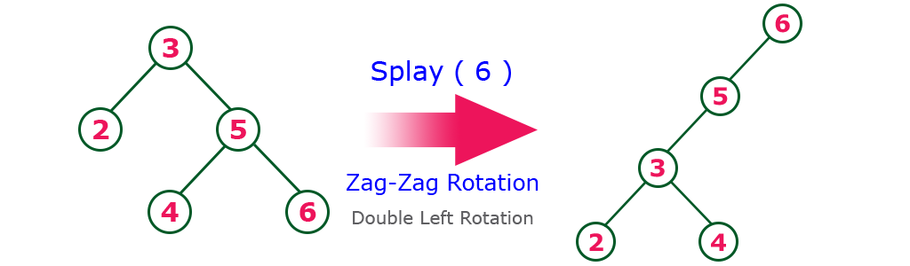
Zag-Zag Rotation
The Zag-Zag Rotation in splay tree is a double zag rotation. In zag-zag rotation, every node moves two positions to the left from its current position. Consider the following example...

Slide 9
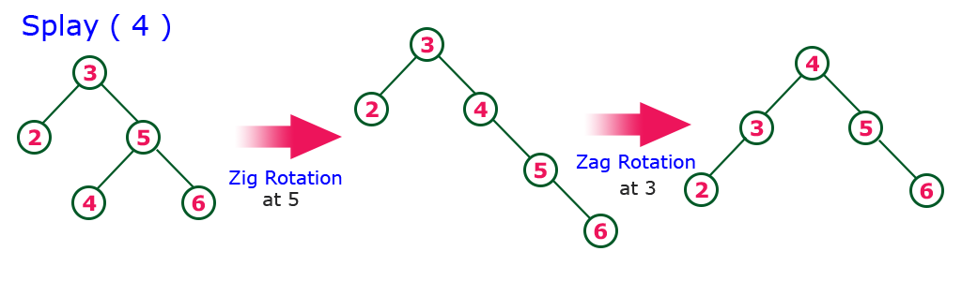
Zig-Zag Rotation
The Zig-Zag Rotation in splay tree is a sequence of zig rotation followed by zag rotation. In zig-zag rotation, every node moves one position to the right followed by one position to the left from its current position. Consider the following example...

Slide 10
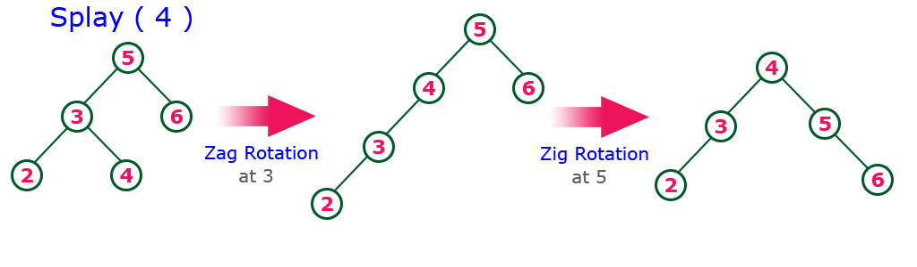
Zag-Zig Rotation
The Zag-Zig Rotation in splay tree is a sequence of zag rotation followed by zig rotation. In zag-zig rotation, every node moves one position to the left followed by one position to the right from its current position. Consider the following example...

Slide 11
Insertion Operation in Splay Tree
The insertion operation in Splay tree is performed using following steps...
Step 1 - Check whether tree is Empty.
Step 2 - If tree is Empty then insert the newNode as Root node and exit from the operation.
Step 3 - If tree is not Empty then insert the newNode as leaf node using Binary Search tree insertion logic.
Step 4 - After insertion, Splay the newNode

Slide 12
Deletion Operation in Splay Tree
The deletion operation in splay tree is similar to deletion operation in Binary Search Tree. But before deleting the element, we first need to splay that element and then delete it from the root position. Finally join the remaining tree using binary search tree logic.

Slide 13
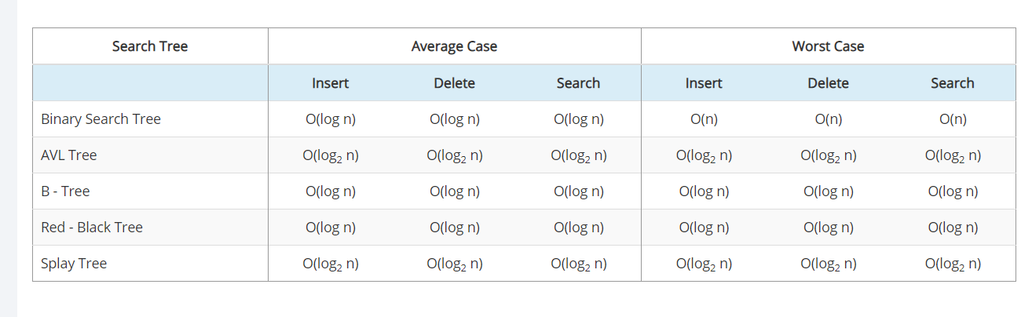
Comparison of Search Trees

Slide 14
Why to prefer splay trees? a) easier to program b) space efficiency c) easier to program and faster access to recently accessed items d) quick searching

Slide 15
What is a splay operation? a) moving parent node to down of child b) moving a node to root c) moving root to leaf d) removing leaf node

